Slide 1
TECHNICAL CHALLENGES/ DETAILS

Slide 2
Technical Details/ Challenges
Hardware
Whether the range of antennae is enough?
What about interference among antennae?
We are using UHF range so minimum interference?
Software
How exactly does software is able to differentiate between users and books?
How does the system know when you remove a book from the RFID?

Slide 3
TRF 7950
Picture of TRF 7950
Picture of library shelf clearly showing top and bottom antannaes..

Slide 4
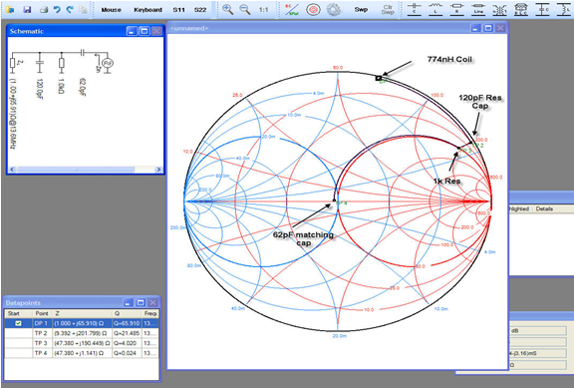
Smith chart - simulations

Slide 5
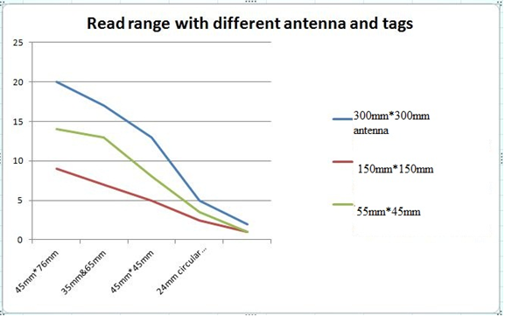

Slide 6
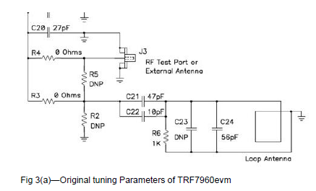
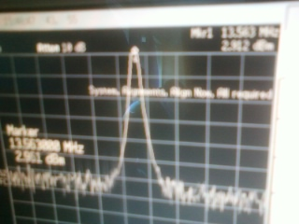
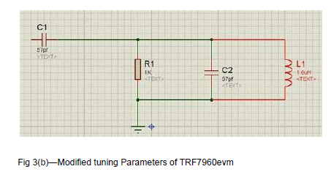
Hardware - Circuits

Slide 7
Software - Mathematical model
Make space for this slide and I will provide the content later..
_Model
Advantages of this model
_how we map the book at any given time
_compare this with the older system
Notes:
This is a very precise and profound description of the system

Slide 8
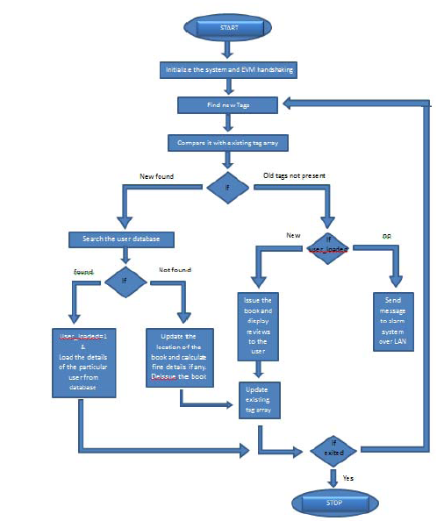
Flowchart
Notes:
Improve the condition of this flow
Possibly include diagrams for visualization of stack or memo (dictionary)

Slide 9
Data structures
Structure of data
User/ Books
(“key”, “value”) pairs uniquely identifiable by “key”.
Value may contain set of entries. These set will act as additional metadata for that “key”.
Book’s name
Author
User’s details etc.
Local copy of tags
Just array of strings

Slide 10
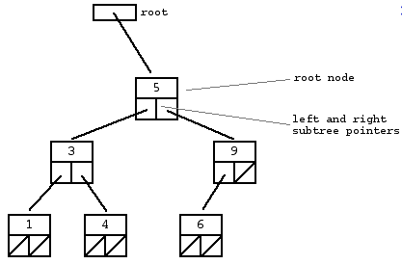
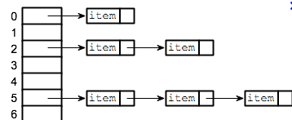
Data structures
Local copy of tags will be small so BST.
Lexicographical order
O(log (n))
A Dictionary/ associative array
Users dictionary will be large
Books dictionary will be largest
~O(1)
Possibly to speed up we may use some caching as well.
Two types is possible

Slide 11
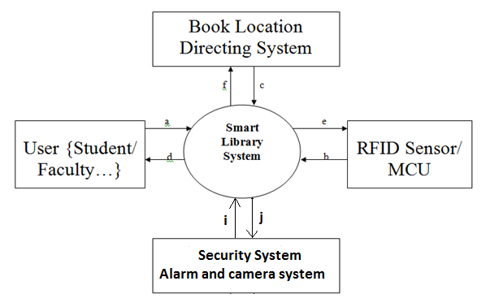
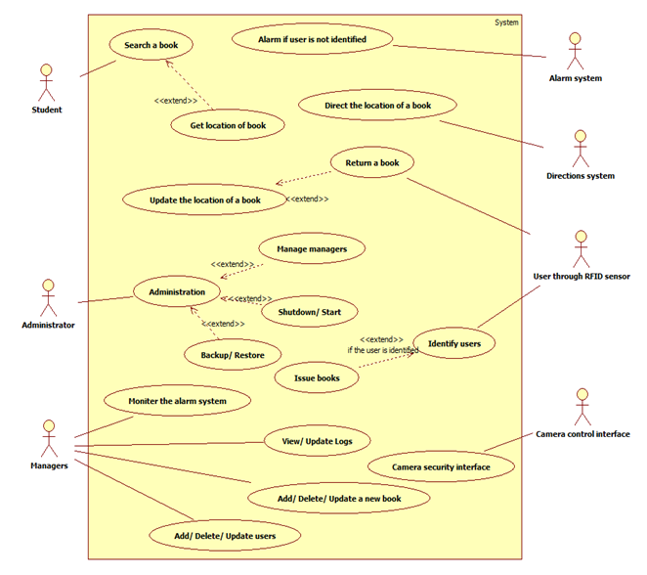
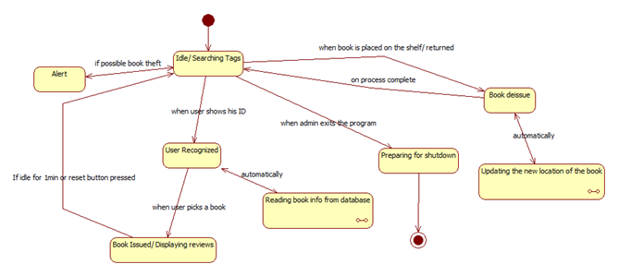
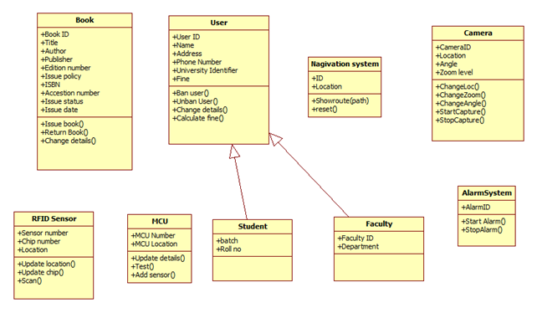
UML Diagrams

Slide 12
CONCLUSION/ WIND UP

Slide 13
Possible refinements
Freedom to place the book anywhere. Curse or boon?
Categories will lose their meaning soon.
Solution
User can be prompted right when he places the book.
Social and economic policies so that users place books are the right location in the first place.
Security
Unique encrypted signature of university in the RFID tag.
Possibly to enhance security we can detect which user is taking which book. Thus having two fold security.
Notes:
wE have enough flexibility by the idea that we are able to map books at any time… so many things can be realised

Slide 14
Feasibility
Economically very viable solution
One time investment is required
Pay off period
Later libraries can use this money to buy books.
Interference among antennae’s
It is possible to make the beam of radio waves for ~1m
Still we need to work out this thing.

Slide 15
Comparison chart
Add comparison chart here…..

Slide 16
video

Slide 17
Thank you accenture yahoo jury members
deepinder
If possible include some references

